Slide 1
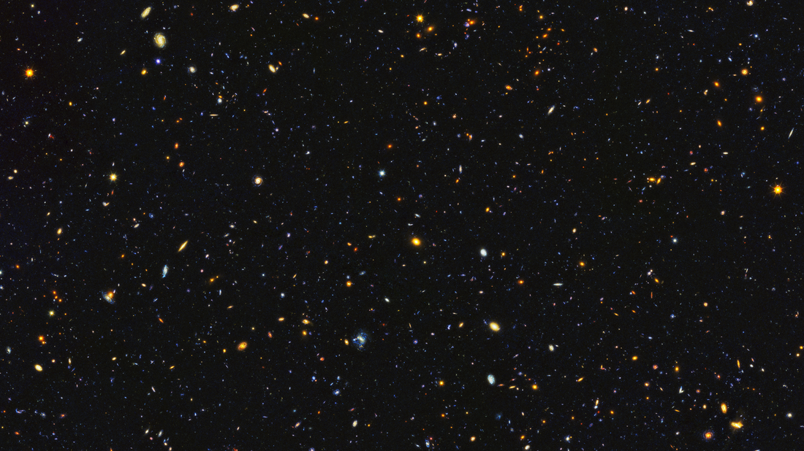

Game Launcher
BBE Tech

Slide 2

About Digital Star Games
Indie gaming company established in 2018.
Previous work includes: 2D space shooter games, open world games.
Current project: Elzia Online Multiplayer game

Slide 3

Requirements List
Based on documentation given to us
Created a questionnaire
Everyone’s input was taken

Slide 4
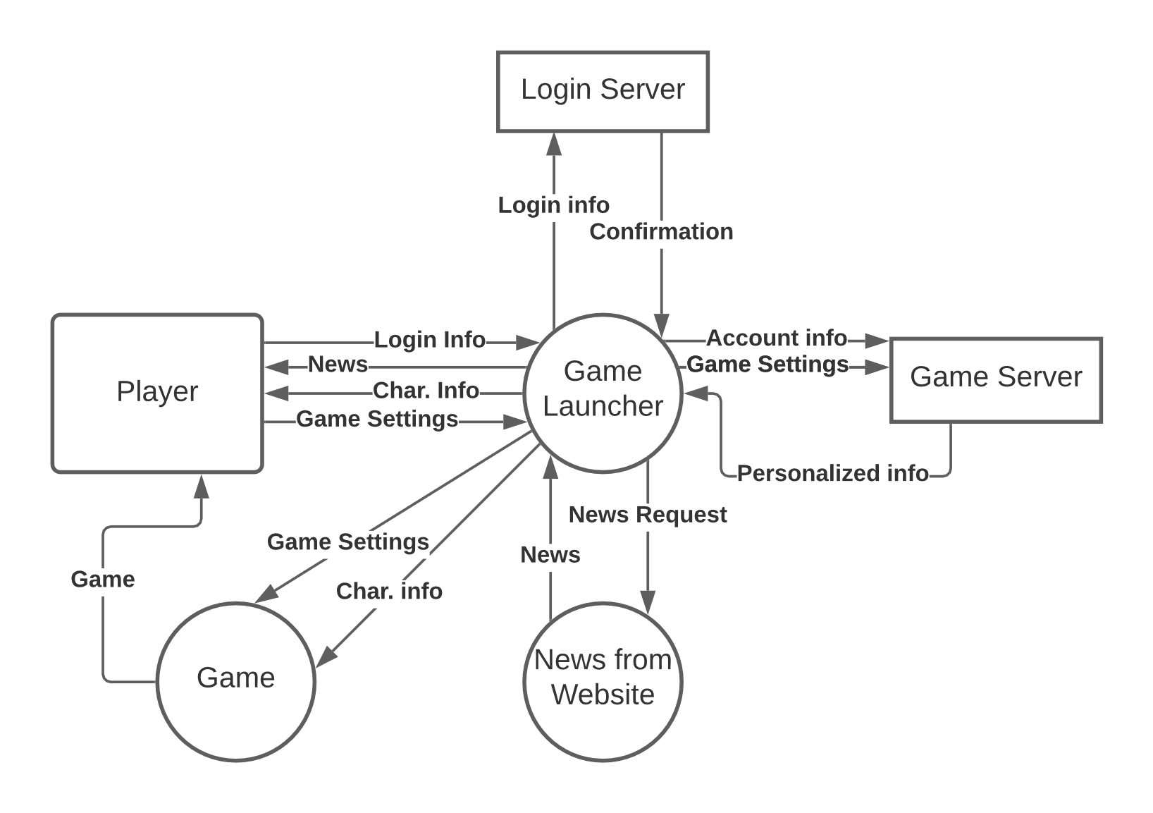
Level 0 DFD
Data is routed through the game launcher to pull requested information from the server and database.
The game launcher will get a response that sends a request to the login server to confirm the users input.
All other diagrams will correspond the same way.

Slide 5
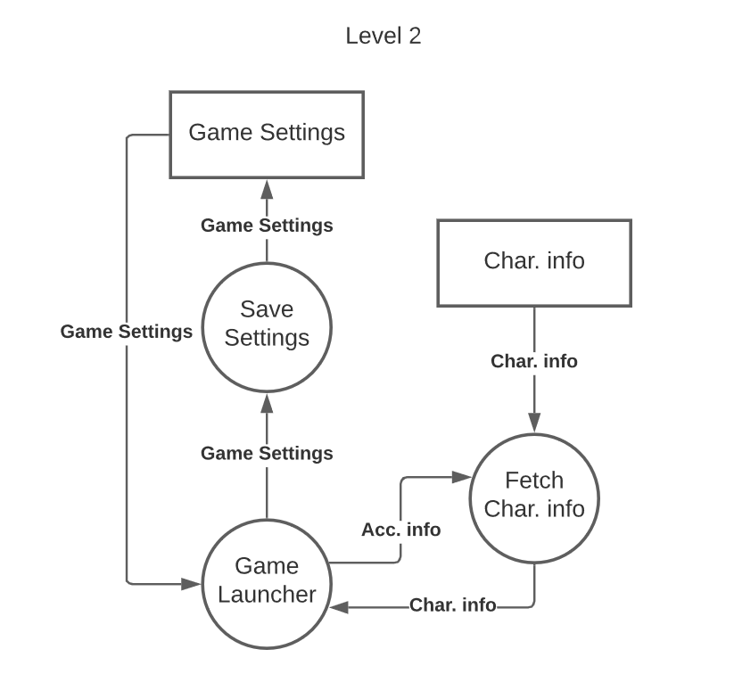
Level 2 DFD
More in-depth look into the data exchange process.
If a player makes a change to the game settings the launcher will check the previously stored save settings.
The settings will be stored and if a change has been made the game server will send a notice which will then update the account info, game settings, and character info.

Slide 6
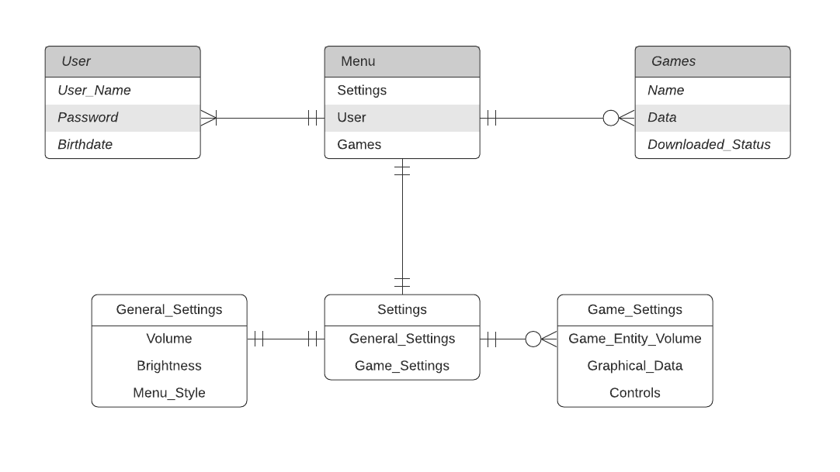
ER-Model
(Mandatory one - optional many)
(Mandatory one - mandatory many)
(Mandatory one - mandatory one)
(Mandatory one - mandatory one)
(Mandatory one - optional many)

Slide 7
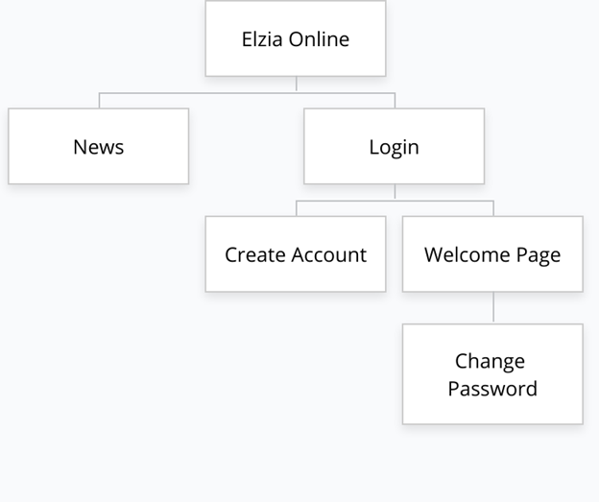
Site Map

Slide 8




Languages Used
C#
All windows
PHP/HTML
Web pages
MySQL
Database for login server

Slide 9



Software Used
Virtual Studio 2019
Linux Terminal
MySQL
PHP
Notepad++

Slide 10


Skills Learned / Challenges
Virtual Communication
Time Management
Meeting Needs of Services

